Slide 1
villlearn

Slide 2
WORK FLOW
Admin Dashboard
--Add content
--Modify content
--view progress
User Signup
Admin Login
Home Page
Mentor Dashboard
--Take quiz
--view leader board
AWS
Mentor Login
Staff Login
Staff Dashboard
--View courses
--Take Quiz
--view leader board
Authentication

Slide 3
HOME PAGE
VillLearn
Description Gallery roll
Login signup
Navigation

Slide 4
LOGIN PAGE
VillLearn
Login
Username
Password
login signup

Slide 5
SIGN UP PAGE
VillLearn
Sign up
Name
ID
User type: staff mentor admin
User name
Password
Re-enter password
Sign up

Slide 6
ADMIN DASHBOARD
MODULE SELECTION:
Health Care
Education
Agri-business
Energy
Content Addition
Content Modification
Track course
Users

Slide 7


MENTOR/STAFF’S DASHBOARD
MODULE SELECTION:
Health Care
Education
Agri-business
Energy
Graphical report
Reward Points
Leader board position
Quiz on
Selected
topic

Slide 8
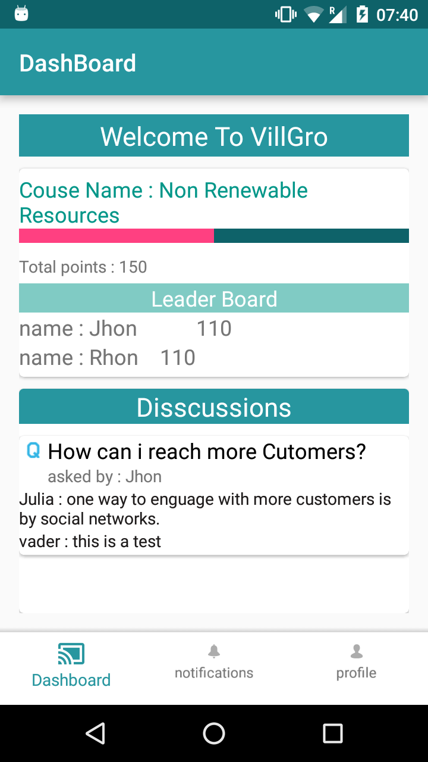
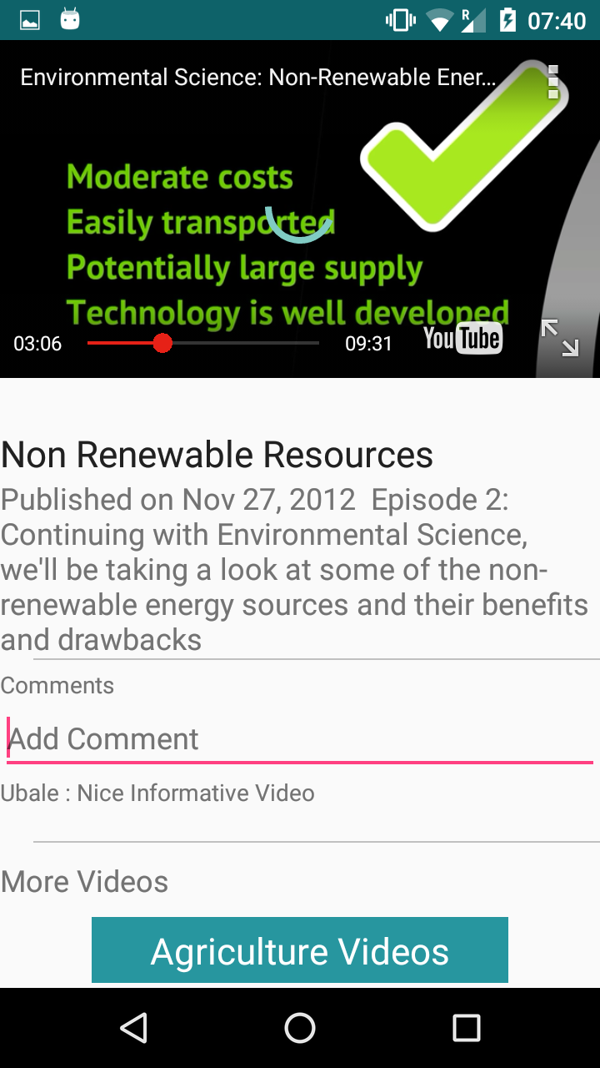
ANDROID APP

